Slide 1
Employee Data Analysis using Excel
STUDENT NAME: PARTHIBAN S
REGISTER NO:312219430/asunm1711312219430
DEPARTMENT: B.COM GENERAL COMMERCE
COLLEGE : S.A.COLLEGE OF ARTS AND SCIENCE

Slide 2
PROJECT TITLE
Employee Performance Analysis using Excel

Slide 3


AGENDA
Problem Statement
Project Overview
End Users
Our Solution and Proposition
Dataset Description
Modelling Approach
Results and Discussion
Conclusion
3/21/2024 Annual Review

Slide 4

PROBLEM STATEMENT
• Analysing employee performance to track their working skills and to motivate the low level employees by various tasks. • To track the performance and give rewards to improve the current performance.

Slide 5
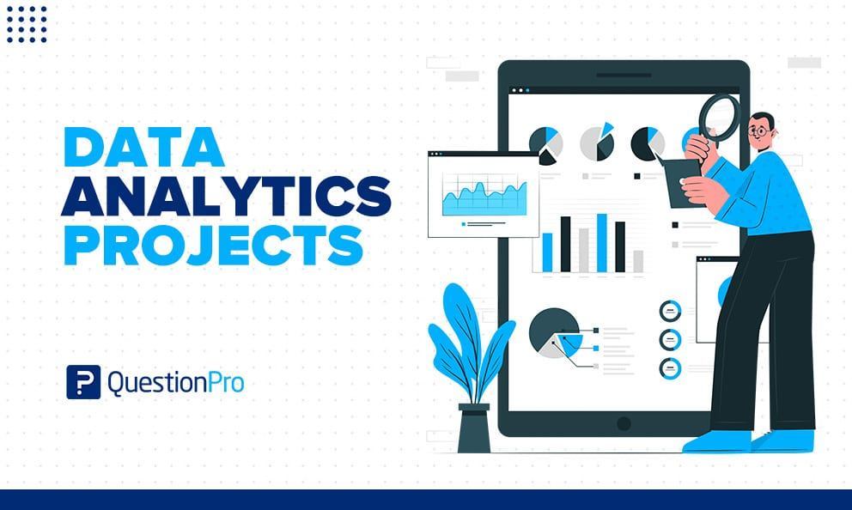
PROJECT OVERVIEW
.
• In this project we known about the employees how they perform by various graph and pivot table • Employee performance analysis is important to identify the performance level toward the project and improve their level by assigning new taks to emerge themselves.

Slide 6


WHO ARE THE END USERS?
• Employees • Organisations • Employers

Slide 7

WHO ARE THE END USERS?
• Employees • Organisations • Employers

Slide 8

OUR SOLUTION AND ITS VALUE PROPOSITION
• Filtering-remove missing • Charts-visualization repots • Pivot tabe-summary • Conditional formatting-identify missing • Formula performance level

Slide 9
Dataset Description
Employee data set the employee datas are taken from the Kaggle to analysis employe performance 9 features Employee ID: Unique identifier for each employee in the organization. First Name: The first name of the employee. Title: The job title or position of the employee within the organization Business Unit: The specific business unit or department to which the employee belongs. Employee Status: The current employment status of the employee (e.g., Active, On Leave, Terminated). Employee Type: The type of employment the employee has (e.g.. Full-time, Part-time, Contract).

Slide 10

THE "WOW" IN OUR SOLUTION
• =IFS(Z30>=5,"VERY HIGH",Z30>=4"HIGH",Z30>=3"MED","TRUE"," LOW"
3/21/2024 Annual Review
10

Slide 11
MODELLING
Data collection The employee performance analysis table are taken from the website called Kaggle. From the data we had some missing figures to identify the missing terms we use conditional techniques to identify the missing terms like exit data etc... Then we used filtering and sorting to fill the missing figues Features collection • Pivot table Charts Conditional formatting
11

Slide 12
Pivot table 1. Click insert 2. From the insert bar click pivot table in new excel sheet 3. Select business unit and drag it in row 4. Then select performance level and drag it in column 5. Select gender in value Performance level From the pivot table we can see the analysis for female male and all and we can access all type of employees by inerting slicers to see how many are full time, part time and contract based employees. Insert graph for better analysis the graph shows the accurate levels and the performance of employees. We can see the various graph by changing the options in the graph options.

Slide 13
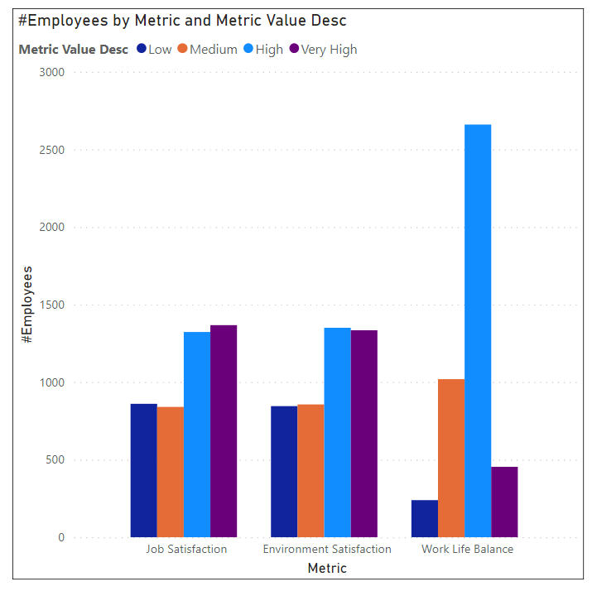
RESULTS
13

Slide 14
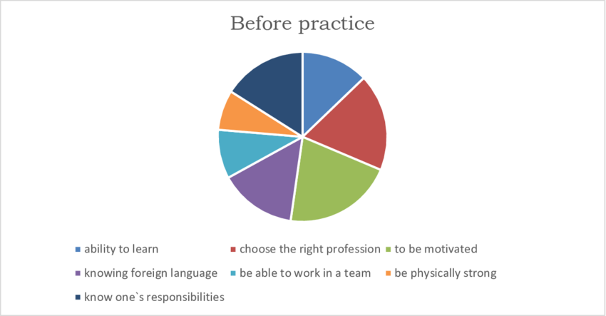

Slide 15
conclusion
• From the above analysis the low level, medium level to be improved by assigning various tasks and training in their field • The current high and very high level employees are improve their intensity by rewards and appreciations towards their growth to increase their participation and to give more potential towards their project.

